Slide 1
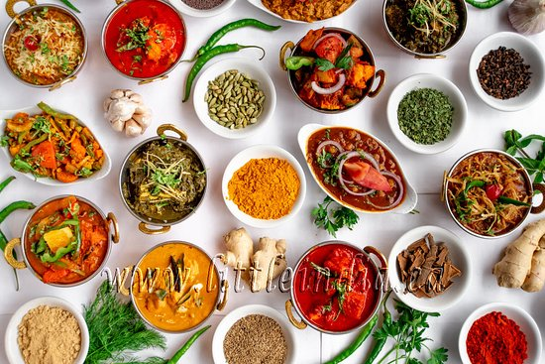
Capstone Project – Battle of Neighborhoods Toronto
Submitted by : Selvaraj Velayudham

Slide 2
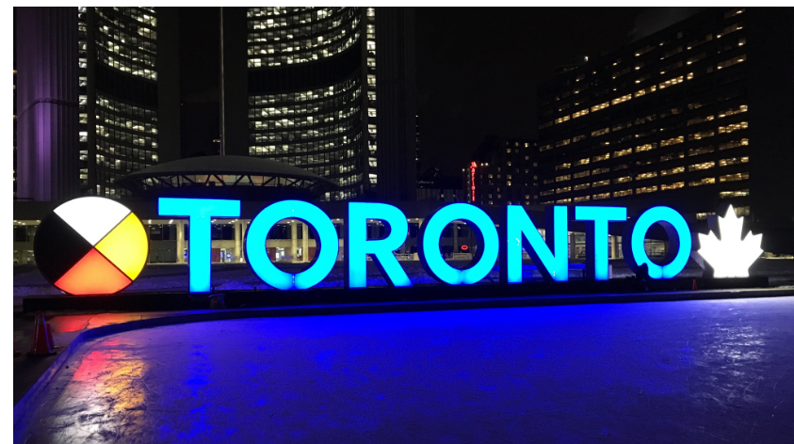
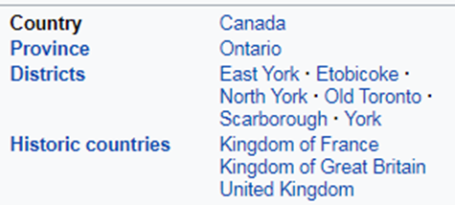
Problem : Identify which Toronto Neighborhood has best Restaurants.
Potential place to open new Restaurant

Slide 3
Introduction
Introduction
Toronto is the provincial capital of Ontario and the most populous city in Canada, with a population of 2,731,571 as of 2016. Current to 2016, the Toronto census metropolitan area (CMA), of which the majority is within the Greater Toronto Area (GTA), held a population of 5,928,040, making it Canada's most populous CMA. The city is the anchor of the Golden Horseshoe, an urban agglomeration of 9,245,438 people (as of 2016) surrounding the western end of Lake Ontario.^{[13]} Toronto is an international center of business, finance, arts, and culture, and is recognized as one of the most multicultural and cosmopolitan cities in the world.
The diverse population of Toronto reflects its current and historical role as an important destination for immigrants to Canada. More than 50 percent of residents belong to a visible minority population group, and over 200 distinct ethnic origins are represented among its inhabitants. While the majority of Torontonians speak English as their primary language, over 160 languages are spoken in the city
According to the 2016 Census, the racial composition of Toronto was: White: 50.2% East Indian: 12.7% (10.8% Chinese, 1.4% Korean, 0.5% Japanese) South Asian: 12.3% Black: 8.5% Southeast Asian: 7.0% (5.1% Filipino) Latin American: 2.8% West Asian: 2.0% Arab: 1.1% Aboriginal: 0.7% (0.5% First Nations, 0.2% Metis) Two or more races: 1.5% Other race: 1.3%
With it's diverse culture , comes diverse food items. There are many restaurants in Toronto, each belonging to different categories like Chinese , Indian , French , Italian etc.
On Jan. 1, 1998, Toronto's amalgamation took effect, merging the six previous municipalities that made up Metro Toronto – Etobicoke, Scarborough, York, East York, North York, and the City of Toronto, into a new singular City of Toronto.
So as part of this project , we will list and visualize all major parts of Toronto that has great Indian restaurants.

Slide 4
source of the data
Data
For this project we need the following data :
Toronto data that contains list Boroughs, Neighborhoods along with their latitude and longitude.
Data source : https://en.wikipedia.org/wiki/List_of_postal_codes_of_Canada:_M
Description : This data set contains the required information. And we will use this data set to explore various neighborhoods of Toronto
Use Beautiful soup to Scrap library
Indian restaurants in each neighborhood of Toronto
Data source : Foursquare API
Description : By using this api we will get all the venues in each neighborhood. We can filter these venues to get only indian Restaurants.
GeoSpace data- 'https://cocl.us/Geospatial_data'
Description : By using this geo space data we will get the Toronto Borough boundaries that will help us visualize choropleth map.
Approach
Collect the Toronto data from https://en.wikipedia.org/wiki/List_of_postal_codes_of_Canada:_M and 'https://cocl.us/Geospatial_data' for Lattitude and Longitude
Using Foursquare API we will find all venues for each neighborhood.
Filter out all venues that are Indian Restaurants.
Find rating , tips and like count for each Indian Restaurants using FourSquare API.
Using rating for each restaurant , we will sort that data.
Visualize the Ranking of neighborhoods using folium library(python)
Conclusion Based on Dataset( Neighborhood rating Likes , rated & Tips)
What is best location in Toronto for Indian Cuisine ?
Which areas have potential Indian Restaurant Market ?
Which all areas lack Indian Restaurants ?
Analysis
We will import the required libraries for python.
pandas and numpy for handling data.
request module for using Foursquare API.
geopy to get co-ordinates of Toronto
folium to visualize the results on a map

Slide 5
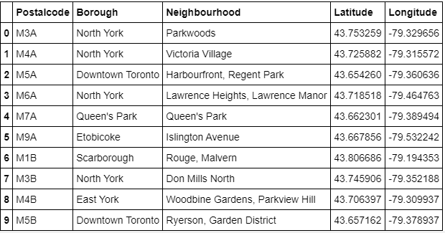
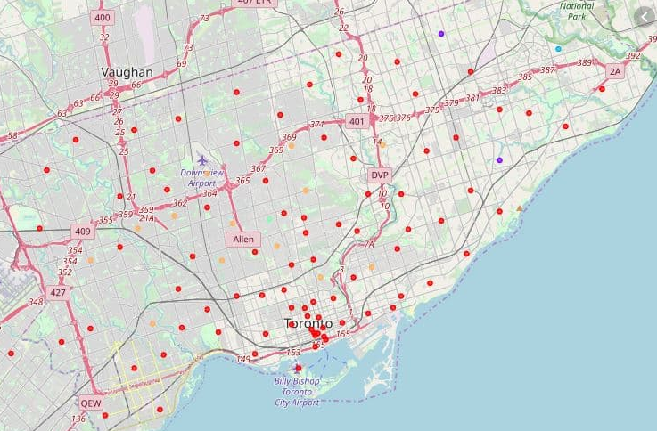
Methodology
To solve the Problem:
used a Sample data from a Wikipedia with Neighborhood details of Toronto. Which contains Postal code, Borough names Latitude and Longtitude and Neighborhoods in Toronto, using Beautifulsoap API.

Slide 6
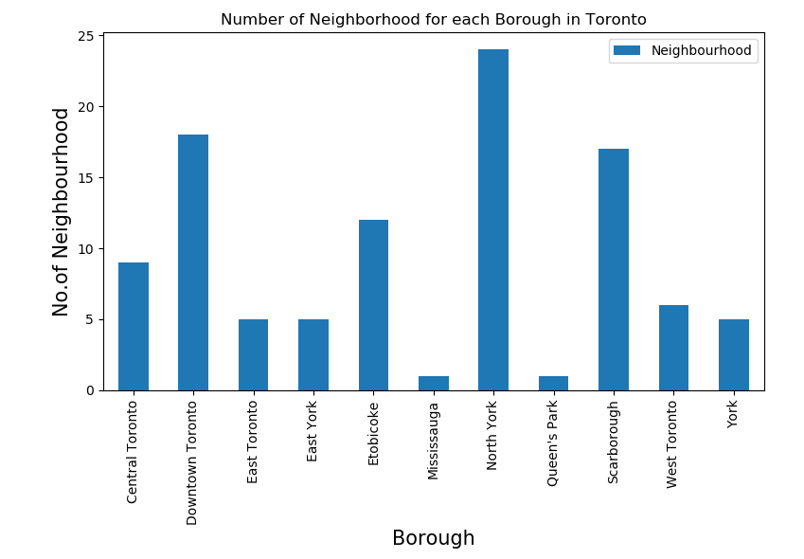
Methodology
Plot Bar Chart to Show No of Neighborhood for Each Borough in Toronto:
My Data Frame Has 11 Borough and 103 Neighborhood

Slide 7
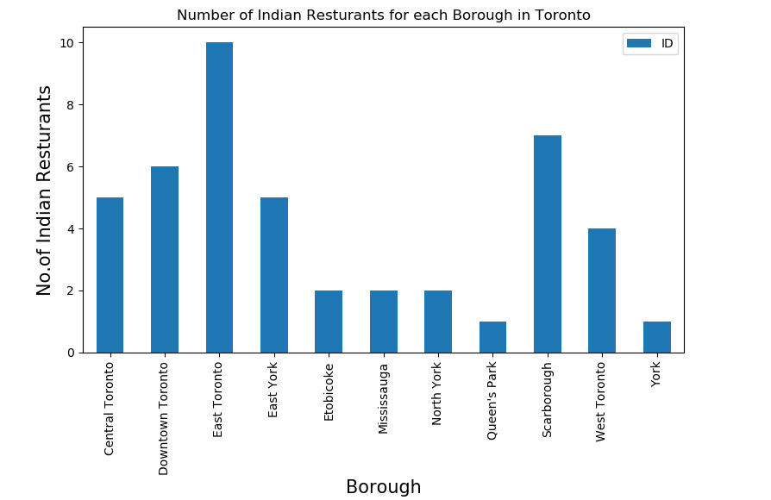
Methodology
Bar Chart to Show No of Indian Restaurants for Each Borough
Used Foursquare API to venue details – No of Indian Restaurants for Each Borough

Slide 8
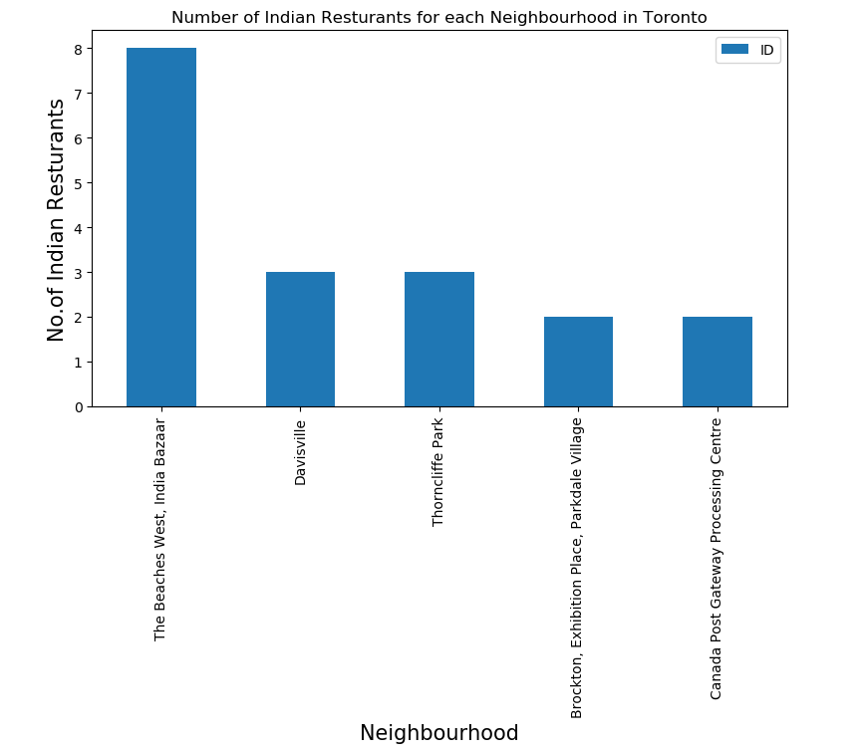
Methodology
Bar Chart to Show No of Indian Restaurants for Each Neighborhood :
Used Foursquare API to venue details – No of Indian Restaurants for Each Neighborhood

Slide 9
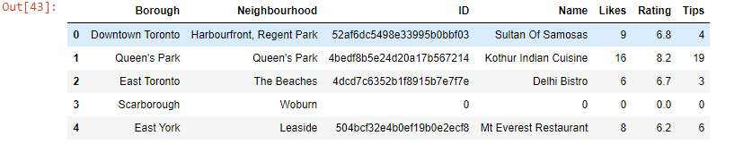
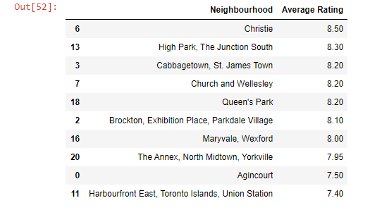
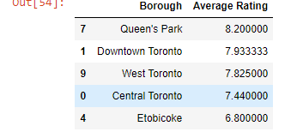
Methodology
Used Foursquare API to Get Name of the Restaurant , Likes , Rating , Tips
Each Neighborhood Average Rating
Each Borough Average Rating

Slide 10
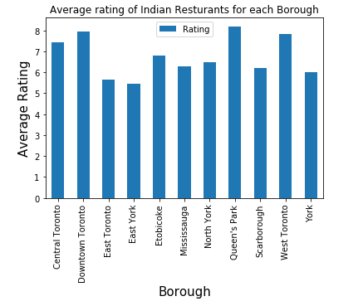

Results
Result section – Average rating of each neighborhood ,Borough, Likes , tips
Each Neighborhood Average Rating
Each Borough Average Rating
Bart Chart for Each Borough Average Rating
Used Foursquare API to Get Name of the Restaurant , Likes , Rating , Tips

Slide 11
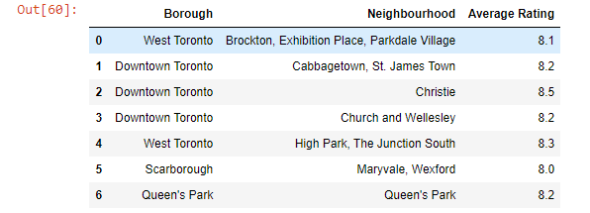
Discussion
Discussion section for Data observation and Recommendation
Bart Chart for Each Borough Average Rating
Each Borough and Neighborhood Average Rating

Slide 12

Conclusion
Each Borough and Neighborhood Average Rating
Each Borough Average Rating
Conclusion – Based on Above Data
Downtown Toronto(Christie), Downtown Toronto Cabbage town, St. James Town )are some of the best neighborhoods for Indian cuisine.
Queen's Park have potential Indian Restaurant Market
Etobicoke ranks last in average rating of Indian Restaurants.

